Slide 1









My Number Interactive Notebook
$$×$$
$$\frac{1}{2}$$
$$÷$$
$$+$$
$$−$$
$$\frac{3}{5}$$
$$7$$
Name
Class
Teacher
Term 3 Semester 2
$$5^{2}$$
$$\sqrt{9}$$
1

Slide 2
Contents
Glossary or Formula Page
Page
Date
Description
2
3

Slide 3

Tasks
24
7
30
Essential Question
Don’t forget to keep your INB up to date
Questions
Notes
You should be ticking these off!
Summary
Have YOU been doing your summaries?
Your book, your responsibility!

Slide 4
Take a guess!
How many stars do you think there are in the (observable) universe?
100 billion stars in the Milky Way and 100 billion galaxies in the universe so…
10 000 000 000 000 000 000 000
And that’s at the conservative end!!!
What about sand on every beach in the world?
Or atoms in one grain of sand?
You’ll find out tomorrow

Slide 5
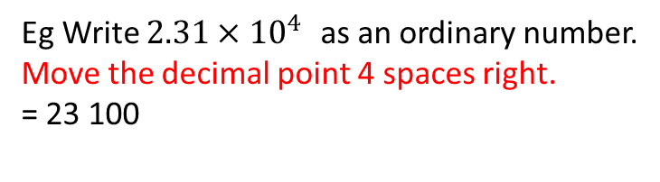
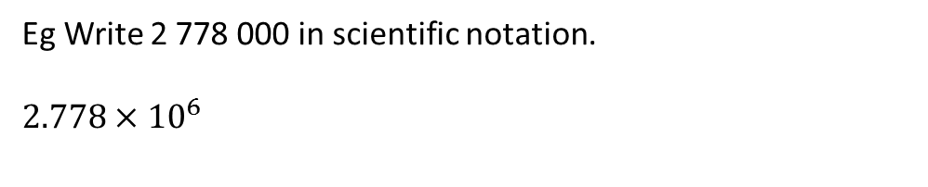
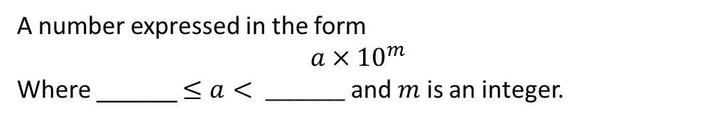
24
7
30
Date
Scientific Notation
EQ – How is scientific (index) notation used to write very large or very small numbers?
What is scientific notation or standard form?
Examples
A number expressed in the form
$$a×{10}^{m}$$
Where ______ $≤a< ________$ and $m$ is an integer.
Eg Write 2 778 000 in scientific notation.
$$2.778×{10}^{6}$$
The number of digits past the first digit
Eg Write $2.31×{10}^{4 }$as an ordinary number.
Move the decimal point 4 spaces right.
= 23 100
11

Slide 6
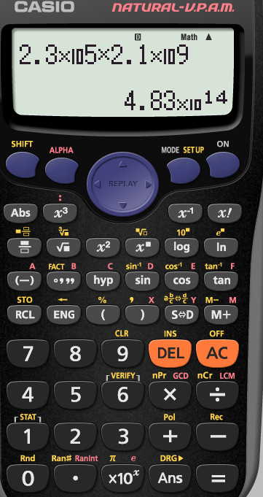
Some calculators use
EXP
Use for scientific notation

Slide 7





Let’s try these together

Slide 8
Now you try
Page 148 11.10 and 11.11

Slide 9
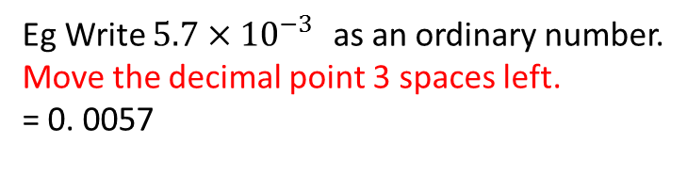
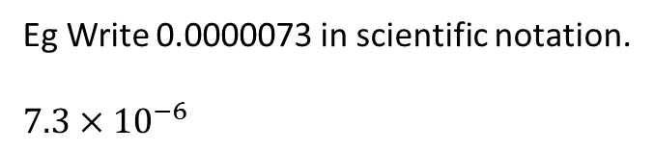
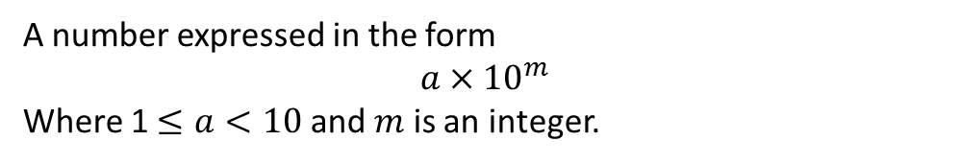
24
7
30
Date
Scientific Notation
EQ – How is scientific (index) notation used to write very large or very small numbers?
What is scientific notation or standard form?
Examples
A number expressed in the form
$$a×{10}^{m}$$
Where 1 $≤a<10$ and $m$ is an integer.
Eg Write 2 778 000 in scientific notation.
$$2.778×{10}^{6}$$
The number of digits past the first digit
Eg Write $2.31×{10}^{4 }$as an ordinary number.
Move the decimal point 4 spaces right.
= 23 100
Eg Write 0.0000073 in scientific notation.
$$7.3×{10}^{−6}$$
The number places the decimal point moves
Eg Write $5.7×{10}^{−3 }$as an ordinary number.
Move the decimal point 3 spaces left.
= 0. 0057
11

Slide 10



Let’s try these together

Slide 11
Now You Try
Page 149 Ex 11.12 an 11.13

Slide 12
Notes Review
24, 7 ,30
Date
Title
Essential question
Notes complete
Notes complete with colour and diagrams
Questions completed
Contents page filed in
Formula page filled in

Slide 13
Homework
Review your notes and write a summary answering the essential question.

